Slide 1
HOSPITAL MANAGEMENT SYSTEM
1.Sazia Ahmed (191014076)
2.Rabeya Bosri (201014028)
3.Sadia Sultana ( 201014079)
4.Rezowana Zayed Zahin(201014096)
5.Mansuba Tabassum(192014014)

Slide 2
Proposed system
It solves many problems of patients and as well as for admin . For example,
1. Patients: They can book appointment , see any information related to hospital doctors through online using this system. Admit in hospital online. Upload previous report and collects any lab report online and get doctor feedback from online. And pay their bills
2. Admin : It helps admin easily manage patients doctor information and update and retrieve any information. And also helps managing documents like admission form and lab reports. And manage the payment from user.

Slide 3
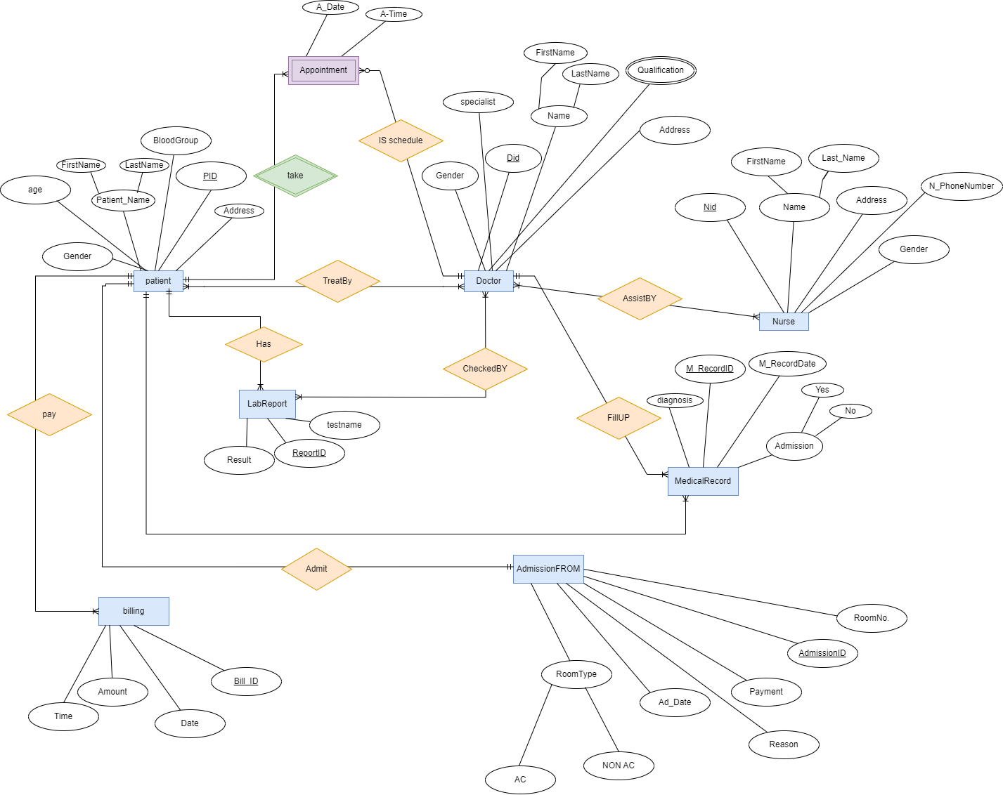
ERD DIAGRAM:

Slide 4
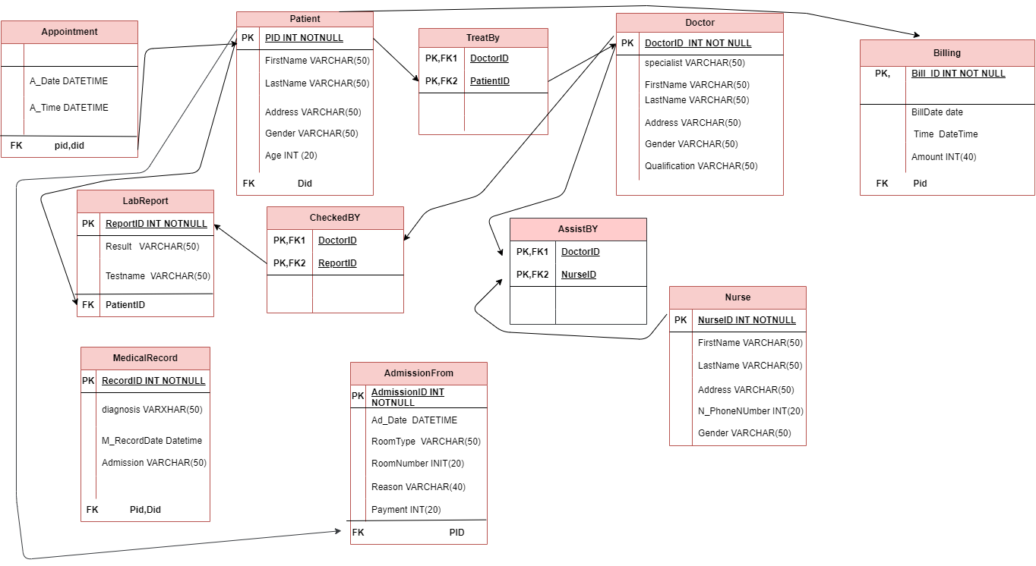

Slide 5
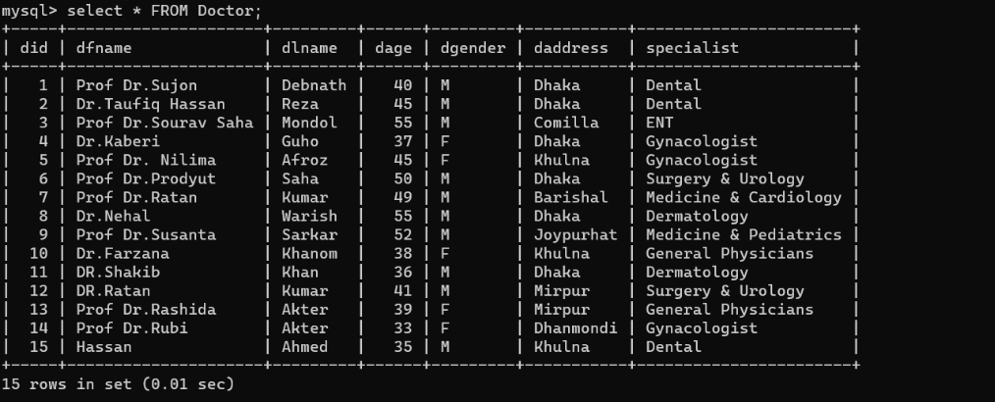
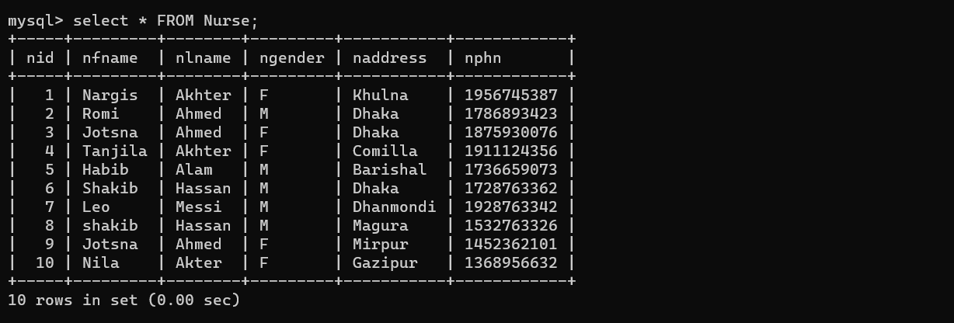
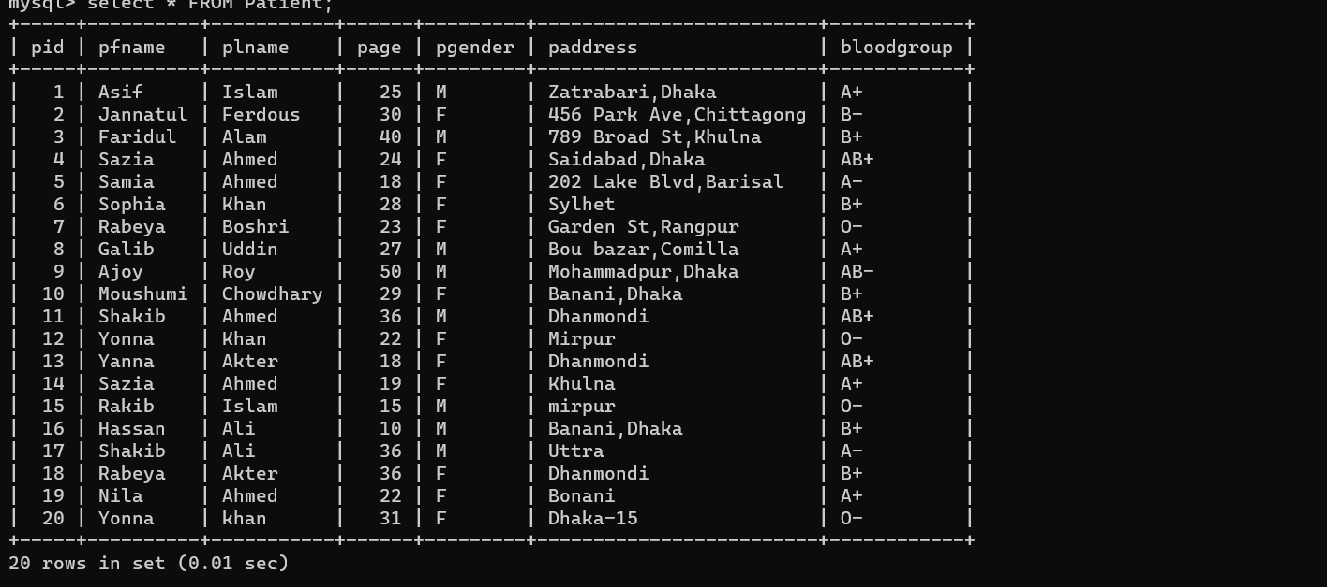
Pictures of tables
Doctor table
Nurse table
Patient table

Slide 6
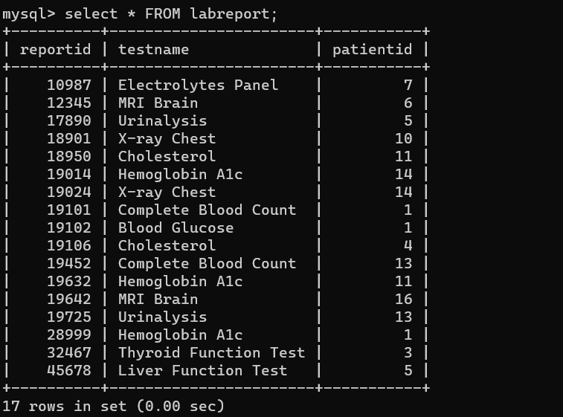
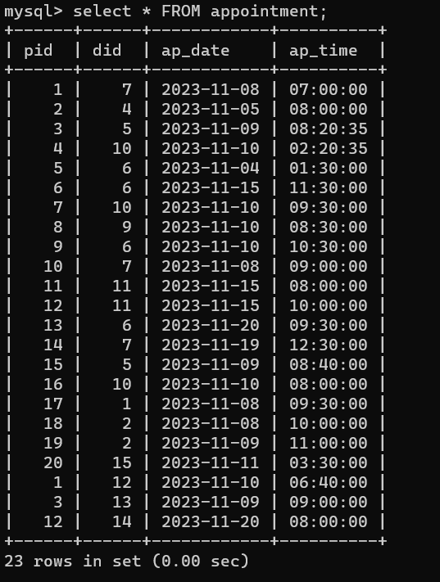
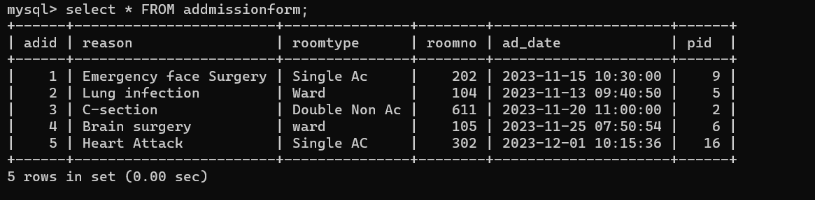
Lab report
Appointment
Admission

Slide 7
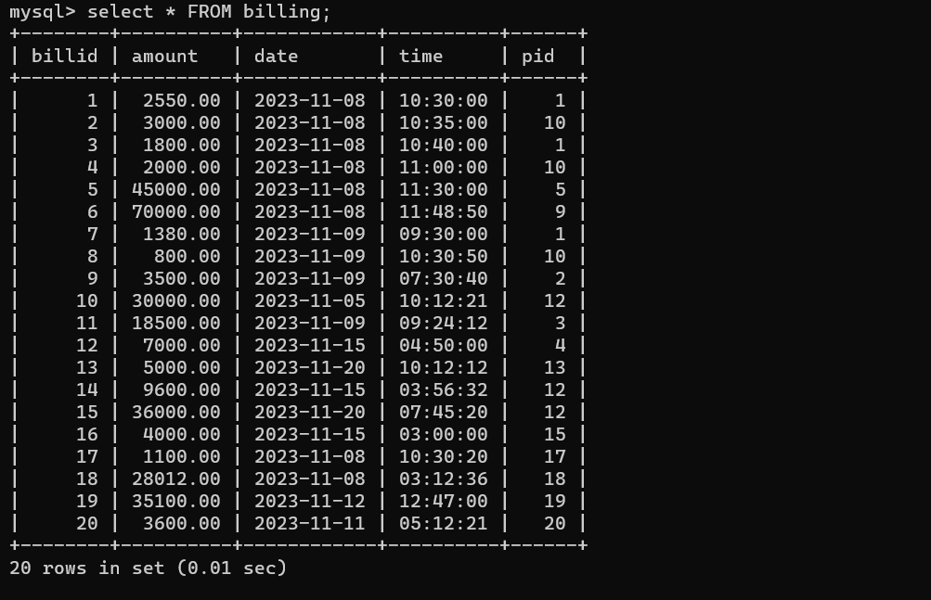
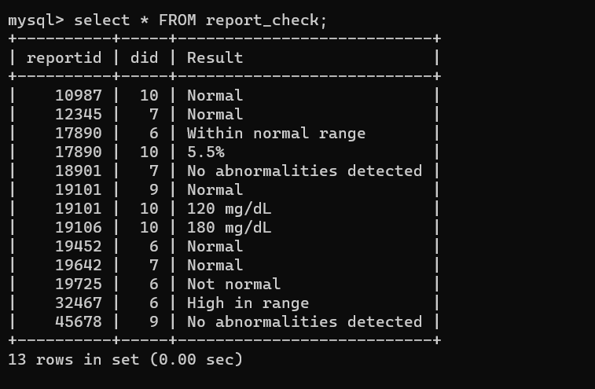
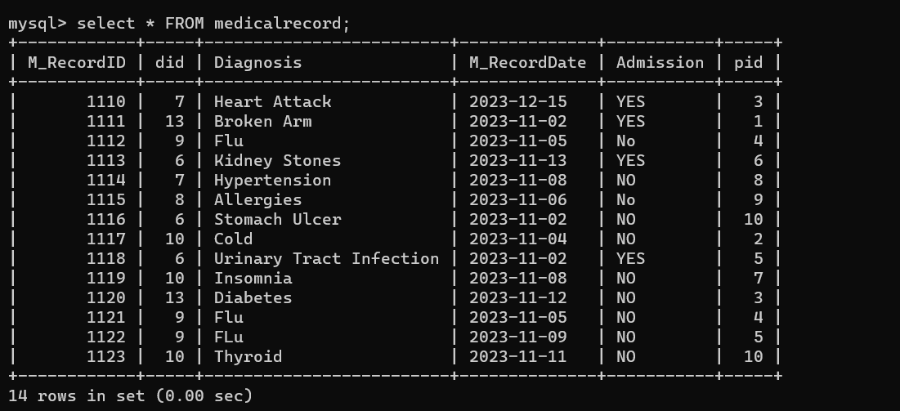
Billing
Report check
Medical record

Slide 8
RELATIONAL CALCULUS:
1) Find the patient name, patient id,patient age from patient table where age is >than 20?
ANS: {t.pfname,t.pid,t.page ∈patient | patient(t)∧t.page>20}
2)Find the name of all doctors who have done BCS degree?
ANS: {t| ∃ d ∈ doctor(t[dfname]=d[dfname]∧ ∃ q ∈ doctor_qualification(q[qualification]="BCS"))}
3) Find the lab report which is belong to patient 1 and patient 11?
ANS: {t |∃.l ∈ labreport (t[testname]=l[testname]∧ ∃ p ∈ patient (p[pid]=1 ∧ p[pid]=11))}
4)Find those bills which are paid in both 8th november 2023 and 9 november 2023?
Ans: {t|∃ b ∈ billing(t[billid]=b[billid]∧(b[date]="2023−11−08"∧
b[date]="2023−11−09"))}

Slide 9
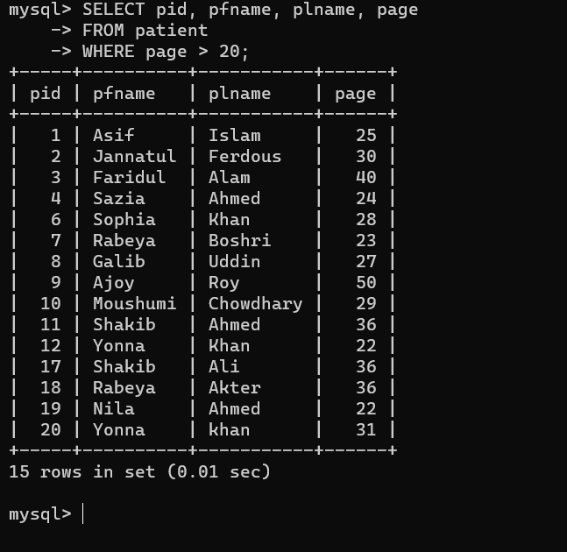
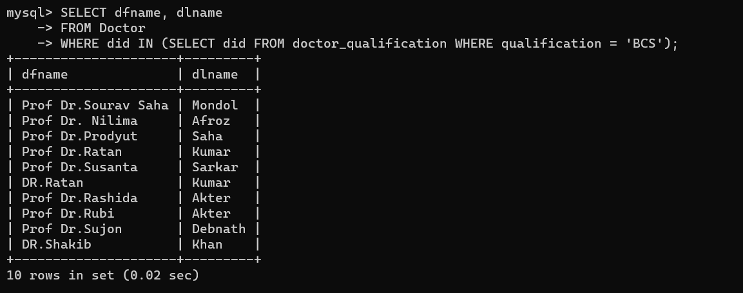
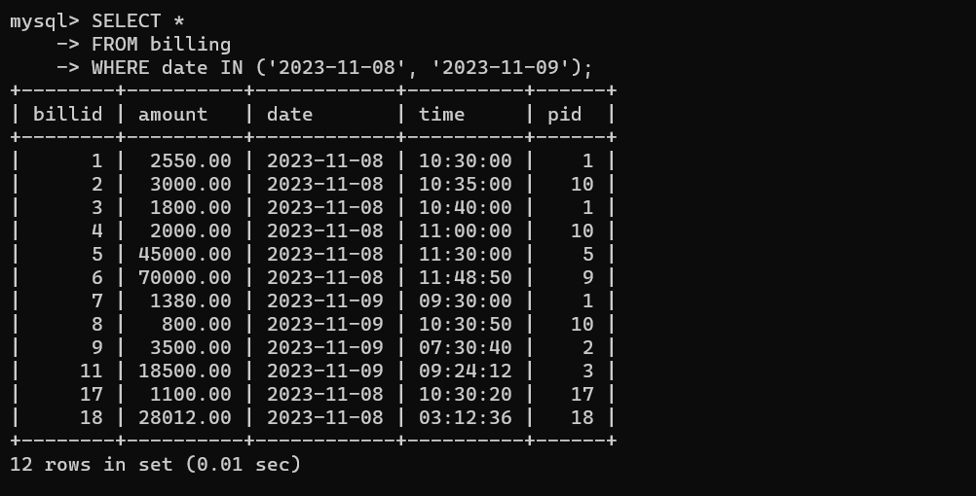
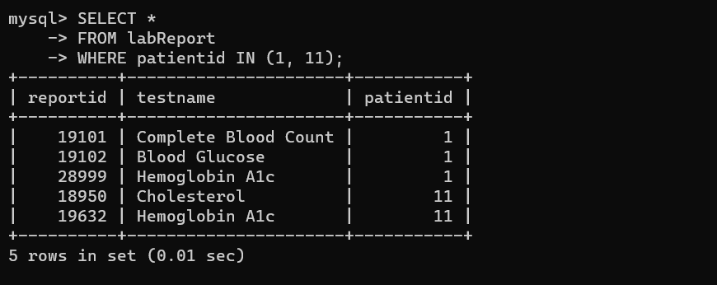

Slide 10
Trigger
DELETE TRIGGER:
Insert trigger:
DELIMITER //
CREATE TRIGGER before_delete_doctor
BEFORE DELETE
ON doctor FOR EACH ROW
BEGIN
INSERT INTO deleted_doctor_info (did, dfname, dlname, daddress, dage, dgender, specialist)
VALUES (OLD.did, OLD.name, OLD.dlname, OLD.daddress, OLD.dage, OLD.dgender, OLD.specialist);
END;
//
DELIMITER ;
DELIMITER //
CREATE TRIGGER after_insert_patient
AFTER INSERT
ON patient FOR EACH ROW
BEGIN
INSERT INTO inserted_patient_info (pid, pfname, plname, page, pgender, paddress, bloodgroup)
VALUES (NEW.pid, NEW.pfname, NEW.plname, NEW.page, NEW.pgender, NEW.paddress, NEW.bloodgroup);
END;
//
DELIMITER ;

Slide 11
Conclusion
Hospital management system makes everything easier for patients and for hospital admin and it reduce the stress of manual paper work. And creates efficiency.

Slide 12
THANK YOU

